Slide 1
Elliptic Curve Cryptography (ECC)

Slide 2
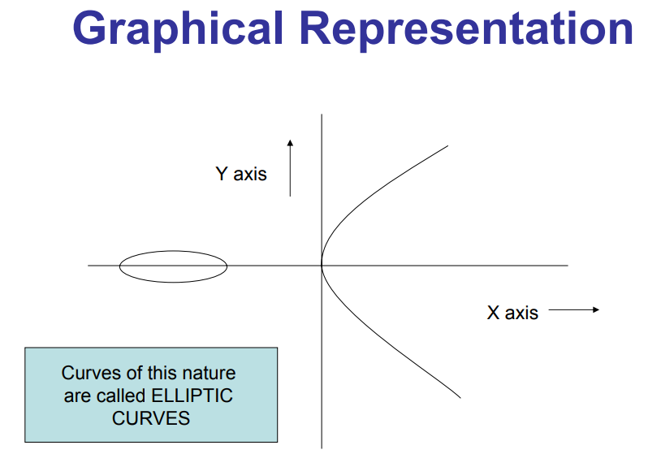
Basics of Elliptic Curve (EC)
Set of points that satisfy a specific mathematical equation.
The cubic equation of an elliptic curve is
Y² ≡ X³ + aX + b for some constants ‘a’ and ‘b’ with the condition 4a³ + 27b² ≠ 0.
Notes:
Lett a=3,b=2 x=2 and y=4( 16=16) These points satisfies the equation
This is the point that satisfies the equation
Like wise we can find all other points
When u find all the points that becomes an elliptic curve
The numbers can real, complex etc it canbe finite field
4a³ + 27b² ≠ 0.(is the determinant)

Slide 3
Types of EC
EC over real number.
EC over complex number.
EC over finite field. (GF(2), GF(5), GF(8),……..)
NOTE: EC over Finite field is used in cryptography.
Equation of EC over FF is:
Y² ≡ X³ + aX + b mod p with the condition
4a³ + 27b² mod p ≠ 0 where a and b should not be greater than p.
P is a finite field
Notes:
EC over finite field is used in cryptography
GF(2), GF(5), GF(8),……..)These are set of finite elements that forms a field. The values of x and y are from a finite field{……..}
Working wih all integers mod 5 , then p is the finite field

Slide 4
1. Construction of EC over Finite field

Slide 5
Construct EC over finite field
Example : Let us consider Z/11 i.e., GF(11)
Set of all integers in GF(11) = {0,1,2,…….,10} satisfies the equation
Y² ≡ X³ + aX + b mod p with the condition
4a³ + 27b² mod p ≠ 0
Let us take a = 1 and b = 1 then check whether this satisfies the condition 4a³ + 27b² mod p ≠ 0
4(1³)+ 27(1)² mod 11 = 31 mod 11 = 9 ≠ 0
Thus a =1 and b =1 satisfies the condition
Notes:
Set of all integers mod 11 is represented as GF(11)
0 mod 11, 1 mod 11, 2 mod 11,,,,,,,,10 mod 11
11 mod 11, 12 mod 11 ………………………repeat{0,1,2,3,4,5,6,7,8,9,10}, We are working with these numbers

Slide 6
Compute all the points on EC
Consider the equation;
Y² ≡ X³ + aX + b mod p, we can rewrite this equation as
Y² mod p = X³ + aX + b mod p(mod arithmetic)
Substitute a = 1, b = 1, and p = 11 in the above equation ;
Y² mod 11 = X³ + X + 1 mod 11
Use the above equation to find all the points in EC.

Slide 7
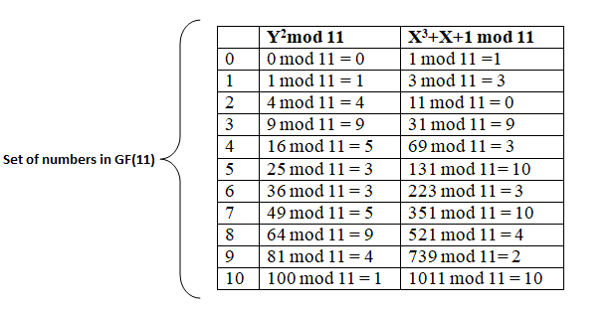
Set of points on the curve
Notes:
The poits that satisfies the equation are
X=0 and y=1
X=0 and y=10
We can construct the curve

Slide 8
In the table, find the values of X and Y to satisfies the equation;
Y² mod 11 = X³ + X + 1 mod 11
For example when X = 0 and Y = 1, we will get the same result which means ‘1’ in the table. So, consider the point (0,1)
Similarly, consider other points such as (0,10), (1,5), (1,6), (2,0), (3,3), (3,8), (4,5), (4,6), (6,5), (6,6), (8,2), (8,9)
Notes:
All these points form an elliptic curve

Slide 9
Plotting elliptic curve E₁₁(1,1)with discovered set of points

Slide 10
2. Check if the point falls on the curve

Slide 11
Check if the point falls on the curve
Check the point (3,8) falls on the elliptic group E₁₁(1,1).
Consider the equation;
Y² mod 11 = X³ + X + 1 mod 11
Substitute X = 3 and Y = 8 in the above equation;
8² mod 11 = 3³ + 3 + 1 mod 11
9 = 31 mod 11
9 = 9
This says that the given point (3,8) satisfies the equation, hence the point (3,8) lies in the curve E₁₁(1,1).

Slide 12
3. Adding two points on the curve
P + Q
P + P
Notes:
Understand certain characteristics on the curve
Out objective is to find P+Q?
P is not equal to Q

Slide 13
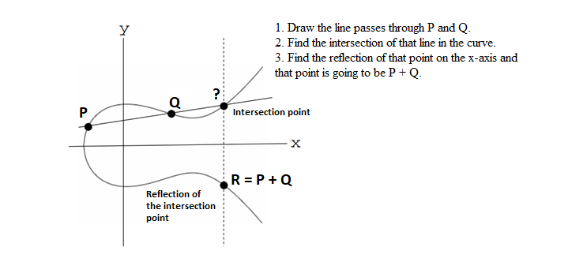
(a) Adding two points P and Q on the EC
Visual representation of adding P and Q on the elliptic curve
Notes:
Project P and Q and this will intersect at a point. Find the reflection of the point. R also lie on the curve. This is one of the characteristics of EC

Slide 14
Algebraic representation of finding P + Q
Let us consider P = (x₁,y₁) and Q = (x₂,y₂) be in the elliptic group E_{p}(a,b) and Q ≠ -P and P ≠ Q.
The rule for addition over the elliptic group E_{p}(a,b) is;
x₃ = λ² - x₁- x₂ mod p
y₃ = λ (x₁- x₃) - y₁ mod p
Where λ = [(y₂-y₁)/(x₂- x₁) ]mod p and P ≠ Q
Notes:
Even without drawing graph, we can find P+Q
Using algebraic equation
R is another point on the curve that satisfies the conditionR(x3,y3)
How to compute delta??

Slide 15
Example – Find R with (3,8) + (6,5) on E₁₁(1,1)
Let us take P = (3,8) and Q = (6,5), here Q ≠ -P and P ≠ Q.
Given; (x₁, y₁) = (3,8) and (x₂, y₂) = (6,5)
1. Compute λ = [(y₂-y₁)/(x₂- x₁) ]mod p
= [(5-8)/(6-3) ]mod 11
= [(-3)/3 ]mod 11
= -1 mod 11
= 11 – (1 mod 11) = 11 -1 = 10
λ = 10

Slide 16
2. Compute x₃ = λ² - x₁- x₂ mod p
= 10² – 3 – 6 mod 11
= 100 – 9 mod 11 = 91 mod 11
x₃ = 3
3. Compute y₃ = λ (x₁- x₃) - y₁ mod p
= 10 (3 - 3) - 8 mod 11
= – 8 mod 11
= 11 – (8 mod 11) = 11 – 8 = 3
y₃ = 3
Hence, by adding (3,8) and (6,5) , we will get the resultant point (3,3).
Now we need to check whether this resultant point (3,3) lies on the curve E₁₁(1,1)

Slide 17
Check (3,3) lies on E₁₁(1,1)
Let us consider the equation,
Y² mod 11 = X³ + X + 1 mod 11
Substitute X = 3 and Y = 3 in the above equation ;
3² mod 11 = 3³ + 3 + 1 mod 11
9 = 31 mod 11
9 = 9
It satisfies the equation. Therefore, the resultant point (3,3) is also lies in the elliptic group E₁₁(1,1).
Notes:
E(1,1) EC constructed with all integers a=1 and b=1

Slide 18
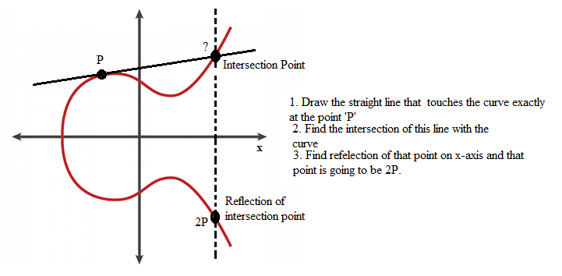
(b) Adding a point ‘P’ with ‘P’
NOTE: Doubling of points
(Multiplication)
2P = P + P
3P = P + P + P
4P = P + P + P + P
…………….
NP = Adding ‘P’, N times
Visual representation of P + P
Notes:
Here P=Q
Draw a tangent line on the curve
Take any point on curve and can u find what it is ? (4P or 10P or 20P…) i.e nP=(xn,yn)=n=8778172812812
N is a private key

Slide 19
ECDLP (EC Discrete Logarithm Problem)
Suppose that you are given two points P and Q.
The ECDLP is to find an integer ‘n’ satisfying
Q = P + P +……..+ P = nP
If prime P is large, then it is very difficult to find ‘n’.
The extreme difficulty of the ECDLP yields highly efficient cryptosystems that are in widespread use protecting everything from your bank account to your government’s secrets.

Slide 20
P + P using algebraic expression
Let us consider the point P(x,y) in the elliptic group E_{p}(a,b).
The rules for adding P with P over the elliptic group E_{p}(a,b) is;(Here x1=x2 and y1=y2)
x₃ = λ² - x- x mod p
y₃ = λ (x- x₃) - y mod p
Where λ = [(3x²+a)/(2y) ]mod p

Slide 21
Example
P(4,6) over E₁₁(1,1). Find P + P.
1. Compute λ = [(3x²+a)/(2y) ]mod p
= [(3*4²+1)/(2*6) ]mod 11
= (49/12) mod 11
= 49 mod 11* 12⁻¹ mod 11
= 5 * 1
λ = 5
NOTE:
12⁻¹ mod 11 => (12 * d)%11 = 1 => d = 1
Notes:
Consider a Point P(4,6) . This exist on curve E11(1,1) constructed over set of all integers mod 11

Slide 22
2. Compute x₃ = λ² – x – x mod p
= 5² – 4 – 4 mod 11
= 25 – 8 mod 11 = 17 mod 11
x₃ = 6
3. Compute y₃ = λ (x- x₃) - y mod p
= 5 (4 - 6) - 6 mod 11
= 5(– 2) - 6 mod 11
= -10 – 6 mod 11 = -16 mod 11
= 11 – (16 mod 11) = 11 – 5 = 6
y₃ = 6
Hence, by adding (4,6) and (4,6) , we will get the resultant point (6,6).
Now we need to check whether this resultant point (6,6) lies on the curve E₁₁(1,1)

Slide 23
Check (6,6) lies onE₁₁(1,1)
Consider the equation;
Y² mod 11 = X³ + X + 1 mod 11
Substitute X = 6 and Y = 6 in the above equation ;
6² mod 11 = 6³ + 6 + 1 mod 11
36 mod 11 = 223 mod 11
3 = 3
It satisfies the equation. Therefore, the resultant point (6,6) is also lies in the elliptic group E₁₁(1,1).
Notes:
{……..}, P+Q in the set on adding R is in the same set
Closure –add and result is in the same set

Slide 24
Properties of EC

Slide 25
Properties of EC
Consider the EC ‘E’. The set of points on the curve over a finite field Fp. E(Fp) is a finite abelian group.
Let’s begin by showing that E(Fp) is a group.
Closure: Consider points P, Q ∈ E(Fp) then P + Q ∈ E(Fp). Hence closure holds.
Identity: The identity element is the point at infinity O.
P + O = O + P = P.
Associativity: Consider the points P, Q, R ∈ E(Fp) then
(P + Q) + R = P + (Q + R).
Additive inverse: if x2 = x1, and y2 = -y1, that is P = (x1,y1) and Q = (x2,y2) = (x1,-y1) = -P then P + Q = O.
Hence, E(Fp) is a group.
E(Fp) is an abelian, for points P, Q ∈ E(Fp), P + Q = Q + P. Hence, E(Fp) is an abelian group.
Notes:
Ellitip curve constructed over fiite is finite abelian group
Elliptic curve built over a finite fieldE(Fp)
Q is written as -P
P+ (-P) = O ( point at infinity

Slide 26
Elliptic Curve Cryptography (ECC)

Slide 27
Elliptic Curve Cryptography
Use the concept of EC in cryptography & it is an Asymmetric cryptography technique.
Steps:
Encode a plain text message as a point on the curve.
Establish private key and public key.
Encrypt the message using public key.
Decrypt the message using private key.
Notes:
1. Message M is a point on the curve built over a finite field
Take a string or any message and encode this message as a point , which belongs to the point constructed over a finite field
2. , 3 and 4 are understandable

Slide 28
Step-1
Encode the plaintext m to be sent as an x-y point P_{m}.
There are relatively straightforward techniques to perform such mappings.
Require a point G and an elliptic group E_{p}(a,b) as parameters.
Example:
Let us take P_{m} = (4,6) where P_{m} ∈ E₁₁(1,1)
Notes:
E₁₁(1,1), Elliptic curve built over the finite field , set of all integers mod 11.with a=1 and b=1.
Lets consider one of the point on this curve as plain text message
Message should be encoded as a point on the curve

Slide 29
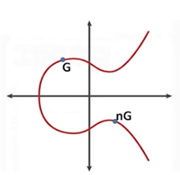
Step - 2
Establish a public and private keys:
Select a private (secret) key ‘n’, where 1 ≤ n ≤ p-1.
Choose the generator point G ∈ E_{p}(a,b).
Compute the public key as P_{U} = n*G.
G = (1,5) ∈ E₁₁(1,1)
n = 2(Any value 1….10)
Notes:
Ep((a,b)→ is the elliptic curve E(1,1,)
G(1,5)belongs to E(1,1,)
We have considered set of all integers mod 11. so n should range between 1 to 10

Slide 30
Step-2 : Example
G = (1,5) ∈ E₁₁(1,1)
n = 2
Public key(P_{U} ) = n*G = 2G (adding point G two times)
To find 2G = (1,5) + (1,5):
Compute λ = [(3x²+a)/(2y) ]mod p
= [(3(1²)+1)/(2*5) ]mod 11
= (4/10) mod 11
= 4 * 10⁻¹ mod 11
= 4 * 10 mod 11 = 40 mod 11 = 7
λ = 7
NOTE: To find the multiplicative inverse
10⁻¹ mod 11 →[(10*d)%11] = 1 → here d = 10

Slide 31
Compute x₃ = λ² – x – x mod p
= 7² – 1 – 1 mod 11
= 49 – 2 mod 11 = 47 mod 11
x₃ = 3
Compute y₃ = λ (x- x₃) - y mod p
= 7 (1 - 3) - 5 mod 11
= - 19 mod 11
= 11 – (19 mod 11)
= 11 – 8
y₃ = 3
Therefore, the coordinates of 2G is (3,3).
P_{m} = (4,6)
P_{U} = (3,3)
n = 2
G = (1,5)

Slide 32
Step – 3(Encryption)
Encryption:
Choose a random positive number ‘k’ where 1 ≤ k ≤ p-1.
Then produces a ciphertext C_{m} as a pair points: C_{m} = {kG, P_{m}+kP_{U}}
C₁ = kG and C₂ = P_{m}+kP_{U}
Notes:
K is from 1 to 10, Hence k=2
G(1,5)
M(4,6) on the curve
Pu=(3,3)
C=c1,c2

Slide 33
Step – 3 : Example
Lets take k = 2
Compute C₁ = kG = 2G = (3,3) + (3,3)
(3,3) + (3,3):
Compute λ = [(3x²+a)/(2y) ]mod p
= [(3(3²)+1)/(2*3) ]mod 11
= (28/6) mod 11
= 28 * 6⁻¹ mod 11
= 28 * 2 mod 11
λ = 1
Notes:
K is from 1 to 10, Hence k=2
G(1,5)
M(4,6) on the curve
Pu=(3,3)
C=c1,c2
(3,3 ) +(3,3) adding a point on the curve

Slide 34
Compute x₃ = λ² – x – x mod p
= 1² – 3 – 3 mod 11
= 1 – 6 mod 11
= -5 mod 11 = 11 – (5 mod 11) = 11 - 5
x₃ = 6
Compute y₃ = λ (x- x₃) - y mod p
= 1 (3 - 6) - 3 mod 11
= - 6 mod 11
= 11 – (6 mod 11)
= 11 – 6
y₃ = 5
Therefore, (3,3) + (3,3) = (6,5)
Then C₁ = (6,5)

Slide 35
Compute C₂ = (P_{m}+kP_{U}), where P_{m} = (4,6),
k = 2 and P_{U}=(3,3).
C₂ = (P_{m}+kP_{U})
= (4,6) + 2 (3,3)
As we computed 2 (3,3) = (6,5) so substitute this in the above equation,
C₂ = (4,6) + (6,5)
Now add two different points (4,6) and (6,5) as follows;

Slide 36
Add two different points (4,6) and (6,5)
Compute λ = [(y₂-y₁)/(x₂- x₁) ]mod p
= [(5-6)/(6-4) ]mod 11
= [(-1)/2 ]mod 11
= (-1) * 2⁻¹mod 11
= – 6 mod 11 = 11 – (6 mod 11)
= 11 - 6
λ = 5
Compute x₃ = λ² - x₁- x₂ mod p
= 5² – 4– 6 mod 11
= 25 – 10 mod 11 = 15 mod 11
x₃ = 4
Compute y₃ = λ (x₁- x₃) - y₁ mod p
= 5 (4 - 4) - 6 mod 11
= – 6 mod 11
= 11 – (6 mod 11) = 11 – 6
y₃ = 5
Therefore, C₂ = (4,5)
Finally the encrypted message is C_{m} = (C₁, C₂) = {(3,3),(4,5)}
Notes:
λ, when P not equal to Q is [(y₂-y₁)/(x₂- x₁) ]mod p

Slide 37
Step – 4(Decryption)
Decryption:
Compute P_{m} = C₂ – [n C₁]
Notes:
C=[(3,3).(4,5)]
N=2

Slide 38
Step-4: Example
P_{m} = C₂ – [n C₁], where C₁ = (3,3),
C₂ = (4,5), n=2.
P_{m} = (4,5) – [2(3,3)]
As we computed 2 (3,3) = (6,5) so substitute this in the above equation,
P_{m} = (4,5) – (6,5)
We can rewrite the above equation by considering the following representation;
Notes:
_p is the reflection of P
X, y is (x,-y)

Slide 39
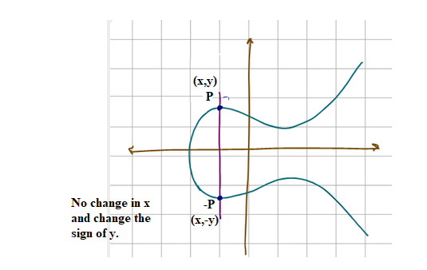
Let consider the following representation;
Where –P is the reflection of P and the difference between P and –P is no change in x and the sign of y varies.
So we can rewrite the equation
P_{m} = (4,5) – (6,5)
= (4,5) + (6,-5)
Here -5 mod 11 = 11 – (5 mod 11) = 11 – 5 = 6, so we replace -5 by 6, then finally we get;
P_{m} = (4,5) + (6,6) Now add these two points
Notes:
-P , here x is same and y is negative
Y coordinate alone change

Slide 40
P_{m} = (4,5) + (6,6) :
Compute λ = [(y₂-y₁)/(x₂- x₁) ]mod p
= [(6-5)/(6-4) ]mod 11
= [1/2 ]mod 11
= 1 * 2⁻¹mod 11
λ = 6
Compute x₃ = λ² - x₁- x₂ mod p
= 6² – 4– 6 mod 11
= 36 – 10 mod 11 = 26 mod 11
x₃ = 4
Compute y₃ = λ (x₁- x₃) - y₁ mod p
= 6 (4 - 4) - 5 mod 11
= – 5 mod 11
= 11 – (5 mod 11) = 11 – 5
y₃ = 6
Therefore, the plaintext P_{m} = (4,6)
Notes:
Here P is not equal to Q , hence λ = [(y₂-y₁)/(x₂- x₁) ]mod p

Slide 41
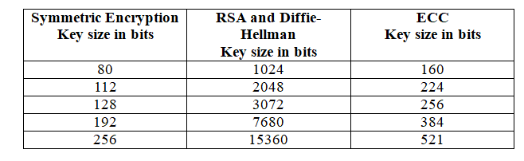
Advantages of ECC over RSA
ECC, it takes one-sixth the computational effort to provide the same level of cryptographic security that you get with 1024 bit RSA and is 15 times faster.
Notes:
ECC offers same level of security as RSA with shorter key length
ECC can run on devices with limited resources like mobile

Slide 42
Because of the much smaller key sizes involved, ECC algorithms can be implemented on smartcards. Contactless smart cards work only with ECC.
ECC has become important for wireless sensor networks.
ECC is also serving as the standard mode of encryption that is used widely by various web applications.
Popular crypto currencies such as Bitcoin and Ethereum make use of the Elliptic curve digital signature algorithm (ECDSA) particularly in signing transactions due to the security levels offered by ECC.

Slide 43
Try…
(1) Consider an elliptic curve y²=x³-36x, P=(-3,9) , Q=(-2,8) , find P+Q and 2P
(2) Consider an Elliptic curve E23(1,1)
If P=(13,7) what is –P?
(3) Consider P=(3,10) and Q=(9,7) find R

Slide 44
Try…
Consider an elliptic curve y²=x³-36x, P=(-3,9) , Q=(-2,8) , find P+Q and 2P
Answer: P+Q=x3,y3=6,0
2P=25/4 and -35/8
Consider an Elliptic curve E23(1,1)
If P=(13,7) what is -P
Solution
-P=(x,-y)
-P=(13,-7)=(13,16)
3. Consider P=(3,10) and Q=(9,7) from R
Solution
4inverse mod 23 is 6
R=(17,20)
2P =(7,12)

Slide 45
Try…
Suppose that you are going to use the Elliptic Curve Cryptography (ECC) algorithm when communicating with your professor.
Given the following information:
Cubic equation of an elliptic curve Y² = X³ + X + 1 mod 23
Generator Point G = (3,10)
Random integer k = 2.
Compute the following:
(1) Compute your public key P_{U} where P_{U} = 6G.
(2) Encrypt the secret message P_{m} = [12,13] and sent the derived cipher text to your professor.

